Slide 1

CGEMS Phase I Wire Frames
8/16/06

Slide 2
The Cancer Genetic Markers of Susceptibility (CGEMS) project is an NCI enterprise initiative to conduct whole genome association studies to identify genes giving rise to risk of prostate and breast cancer. The project is designed to capitalize on new knowledge of human genetic variation and technical advances in ultra-high throughput genotyping. CGEMS is designed to conduct whole genome scans in nested case-control studies of prostate cancer and breast cancer from large ongoing population-based cohort studies. The detection of genes or regions in the genome that are associated with risk for prostate and breast cancer will be useful for understanding causal pathways, as well as providing tools for risk stratification in the development of preventive interventions. Results from the CGEMS whole genome scans are publicly available from this portal. For accredited investigators, raw genotypic and phenotypic data are also available.
For more information on:
the CGEMS study, please see our Study Web site
data available to the public, please see our <site documentation>.
accessing the raw data, please see the investigator <registration page>.
About…
Browse Data
Bulk Data Download
Feedback
Notes:
Feed back link will lead to a email page for comments.

Slide 3
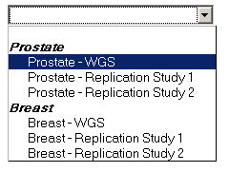
For public users, no login required
login
About…
Browse Data
Bulk Data Download
Feedback
Browse Data:
Association Finding
Population Frequency
Subjects Data (login required)
Genotypes Data (login required)
Select a Study:

Slide 4
login
About…
Browse Data
Bulk Data Download
Feedback
Bulk Data Download:
Data Format Documentation
Association Finding
Population Frequency
Subjects Data (login required)
Genotypes Data (login required)
Select a Study:

Slide 5
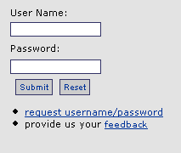
Login pop up
login
About…
Browse Data
Bulk Data Download
Feedback
Browse Data:
Association Finding
Population Frequency
Subjects Data (login required)
Genotypes Data (login required)
Request access to raw data
Select a Study:

Slide 6
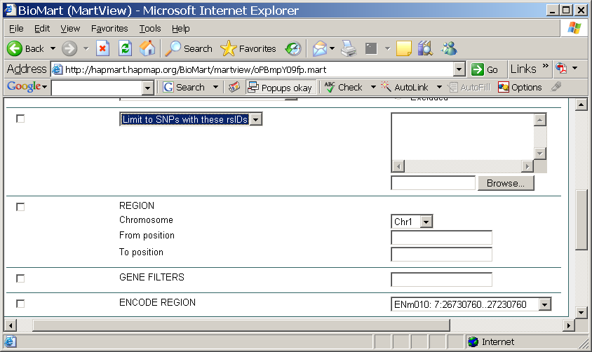
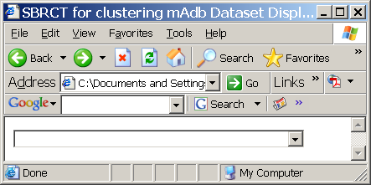
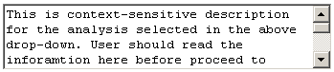
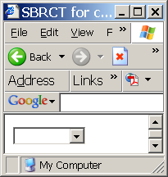
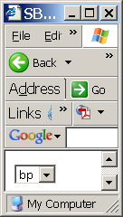
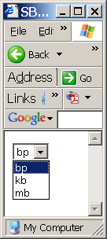
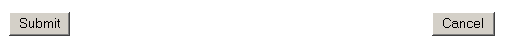
About…
Browse Data
Bulk Data Download
Feedback
Study: Prostate – WGS
Search Association Findings by:
?: Pops open a longer description of the analysis method in a print-able window
Analysis Name:
Analysis Abstract:
?
AND
Genomic Location Chromosome
From
To
(Based on Genome build 35)
Search by cytoband in next version
HUGO Gene Symbol List
(Fill in comma or new line separated list or upload a list file with max. 100 gene symbols via Browse.. button)
dbSNP Identifier List
(Fill in comma or new line separated list or upload a list file with max. 1000 dbSNP ids via Browse.. button)
p-value <=
AND
Whole Genome Rank <=
Notes:
The default for chromosome is blank
The default for chromosome location is bp, value should be integer (not kb or mb)
When the selection for the chromosome location is kb or mb, a float number is allowed
The search will return 500 SNPs or less. If over the limit a ftp file will be generated. User will be notified through email. (see the genotypes use case)

Slide 7
SNP Association Finding Report
dbSNP ID | Chromosome | Physical Position (bp) | Associated Genes | Analysis Name | p-value | Whole Genome Rank
rs1887244 | chr10 | 130394896 |  | Incidence density sampling-contingency table test | 0.000002 | 1
rs1887244 | chr10 | 130394896 |  | Incidence density sampling-score test | 0.000003 | 1
rs11098380 | chr4 | 118451227 |  | Incidence density sampling-contingency table test | 0.000008 | 3
rs11098380 | chr4 | 118451227 |  | Incidence density sampling-score test | 0.000006 | 4

Slide 8
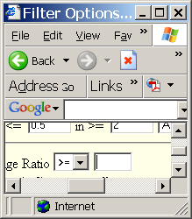
Study: Prostate – WGS
Search SNPs by:
About…
Browse Data
Bulk Data Download
Feedback
Population * :
First element is “ALL” and it is a multi-select drop-down
Genomic Location Chromosome
From
To
(Based on Genome build 35)
Search by cytoband in next version
HUGO Gene Symbol List
(Fill in comma or new line separated list or upload a list file with max. 100 gene symbols via Browse.. button)
dbSNP Identifier List
(Fill in comma or new line separated list or upload a list file with max. 1000 dbSNP ids via Browse.. button)
and
AND
Hardy Weinberg pValue (float)
Minor Allele Frequency (float)
and
Completion Rate (float)
AND

Slide 9
SNP Frequency Report
dbSNP ID | Chromosome | Physical Position (bp) | Associated Genes | Population | Completion Rate (N/M) | Hardy Weinberg p-value | Allele | Allele Count (Frequency) | Genotype | Genotype Count (Frequency)
rs117117 | chr13 | 1234567 | EGFR|PTEN | CEPH | 94% (2300/2450) | 0.0001 | C T | 240 (0.1) 2160 (0.9) | CC CT TT | 125 (0.05) 1500 (0.6) 700 (0.35)
rs8 | chr7 | 92052980 |  | control | 100% (1104/1104) | 0.587104 | C T | 1743(0.789) 465(0.211) | CC CT TT | 691(0.626) 361(0.327) 52 (0.047)
rs16 | chr7 | 11376139 |  | control | 99.909420% (1102/1103) | 0.902489 | G A | 1247(0.565) 959(0.435) | GG AG AA | 351(0.318) 545(0.494) 207(0.188)

Slide 10
About…
Browse Data
Bulk Data Download
Feedback
Study: Prostate – WGS
Search Subject Data by:
Population
Analysis Group
AND
Gender
and
Age in 5 year increments
lower
upper
and
Case control status
and
Family History

Slide 11
Subject Data Report
Study Participant de-identifier ID | Gender | Age (in 5 year increments) | Affection Status | Family History | Population
2218 | MALE | 65-69 | Case-Early |  | PLCO|Case-Early
1378 | MALE | 70-74 | Control |  | PLCO|Control
2422 | MALE | 65-69 | Case-Advanced |  | PLCO|Case-Advanced
1183 | MALE | 60-64 | Case-Advanced |  | PLCO|Case-Advanced

Slide 12
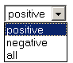
About…
Browse Data
Bulk Data Download
Feedback
Study: Prostate – WGS
Search Genotype Findings by:
AND
Population
Analysis Group
AND
gender
and
Age in 5 year increments
lower
upper
and
Case control status
and
Family History
AND
Genomic Location Chromosome
From
To
(Based on Genome build 35)
Search by cytoband in next version
HUGO Gene Symbol List
(Fill in comma or new line separated list or upload a list file with max. 100 gene symbols via Browse.. button)
dbSNP Identifier List
(Fill in comma or new line separated list or upload a list file with max. 1000 dbSNP ids via Browse.. button)
AND
Status for QC
Notes:
The default for “Status for QC” is positive.
This page always leads to download of the data returned. There is no displaying results.
Zhaoming will write up a help file for QC status details.

Slide 13
About…
Browse Data
Bulk Data Download
Feedback
Study: Prostate – WGS
Proceed to next step:
Fill out email address:
Kevin will draft confidentiality notice here (to be reviewed by legal staff):
You will be notified by email when the results are ready. You will have
48 hours to download from our ftp server. The results cannot be
shared with others as agreed upon login

Slide 14
FTP Genotype Data download Format
dbSNP ID | Study Participant de-identified ID | Allele1 | Allele2 | Quality Score | QC Status | Normalized X Intensity | Normalized Y Intensity | Raw X Intensity | Raw Y Intensity
rs10891753 | 1495 | A | C | 0.7455 | QC+ | 0.152 | 0.575 | 522 | 2350
rs2001911 | 1495 | A | C | 0.7456 | QC+ | 0.755 | 0.661 | 826 | 1294
rs4958553 | 1495 | A | C | 0.7456 | QC+ | 2.517 | 1.436 | 7453 | 5831
rs2281292 | 1495 | A | C | 0.7457 | QC+ | 0.259 | 0.664 | 377 | 1380
rs2838088 | 1495 |  |  | 0.0000 | QC- | 0.051 | 0.105 | 158 | 220

